Slide 1
Math 769: Statistical Learning

Slide 2
Computing Linear Regression
Shahrzad Jamshidi, PhD

Slide 3
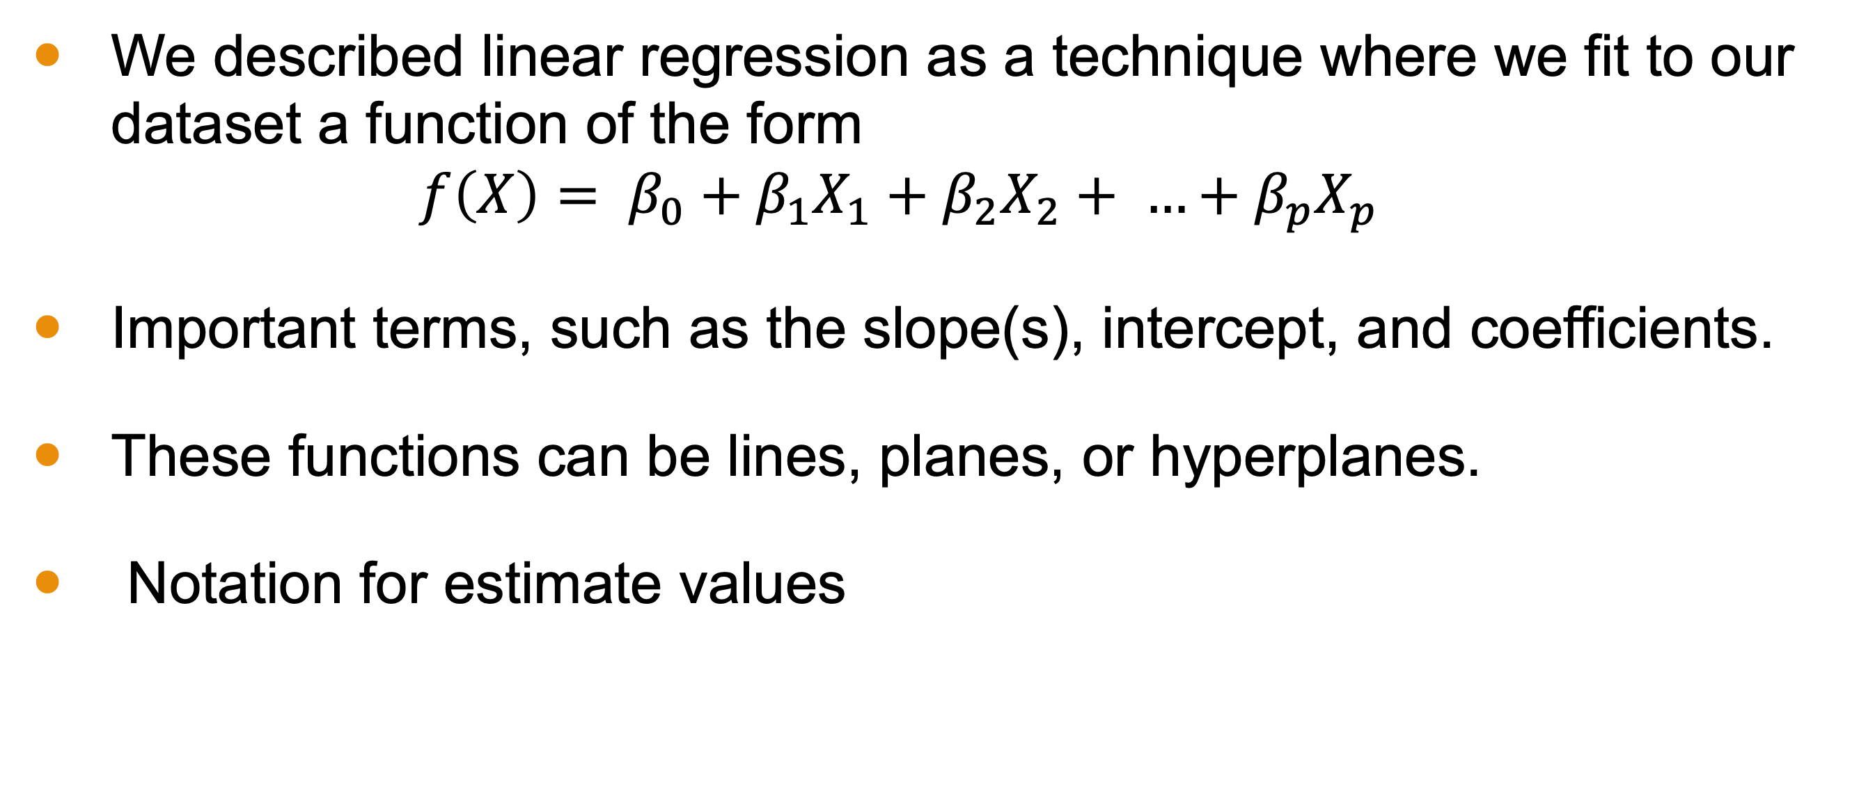
Last Time
We described linear regression as a technique where we fit to our dataset a function of the form $f\left(X\right)= β_{0}+β_{1}X_{1}+β_{2}X_{2}+ …+β_{p}X_{p}$
Important terms, such as the slope(s), intercept, and coefficients.
These functions can be lines, planes, or hyperplanes.
Notation for estimate values

Slide 4
Objectives
Define the loss function used to perform linear regression.
Describe the mathematical process of constructing a linear model.

Slide 5
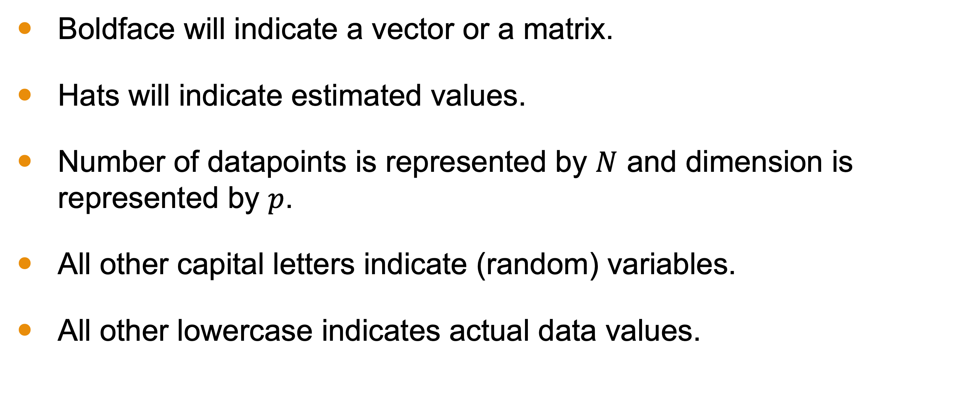
Remarks on Notation
Boldface will indicate a vector or a matrix.
Hats will indicate estimated values.
Number of datapoints is represented by $N$ and dimension is represented by $p$.
All other capital letters indicate (random) variables.
All other lowercase indicates actual data values.

Slide 6
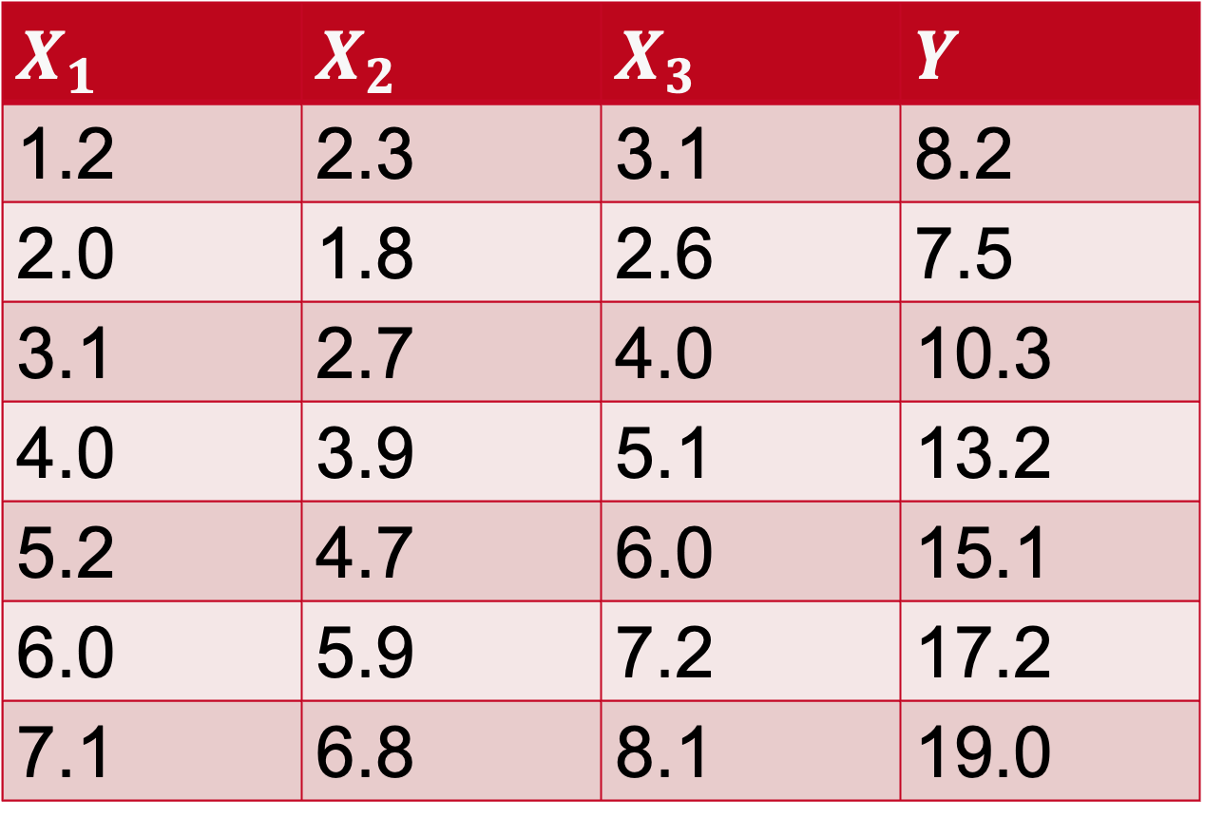
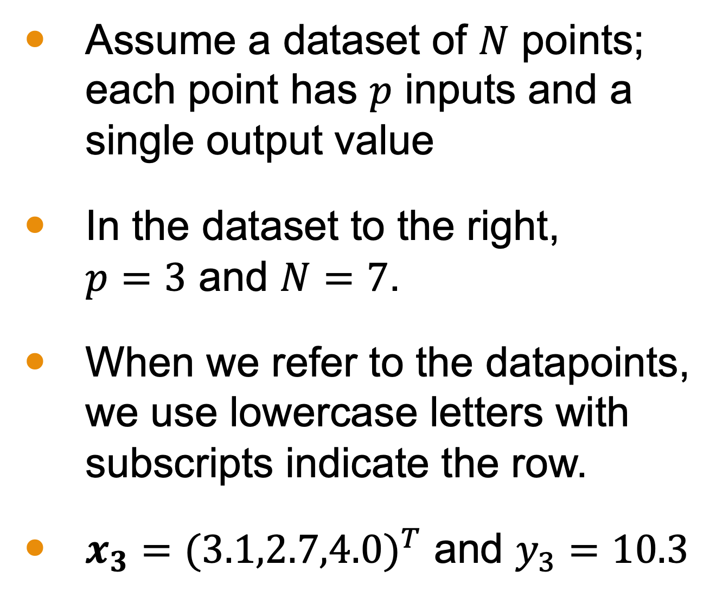
Data
Assume a dataset of $N$ points; each point has $p$ inputs and a single output value
In the dataset to the right, $p=3$ and $N=7$.
When we refer to the datapoints, we use lowercase letters with subscripts indicate the row.
$x_{3}={(3.1,2.7,4.0)}^{T}$ and $y_{3}=10.3$
$$X_{1}$$ | $$X_{2}$$ | $$X_{3}$$ | $$Y$$
1.2 | 2.3 | 3.1 | 8.2
2.0 | 1.8 | 2.6 | 7.5
3.1 | 2.7 | 4.0 | 10.3
4.0 | 3.9 | 5.1 | 13.2
5.2 | 4.7 | 6.0 | 15.1
6.0 | 5.9 | 7.2 | 17.2
7.1 | 6.8 | 8.1 | 19.0

Slide 7
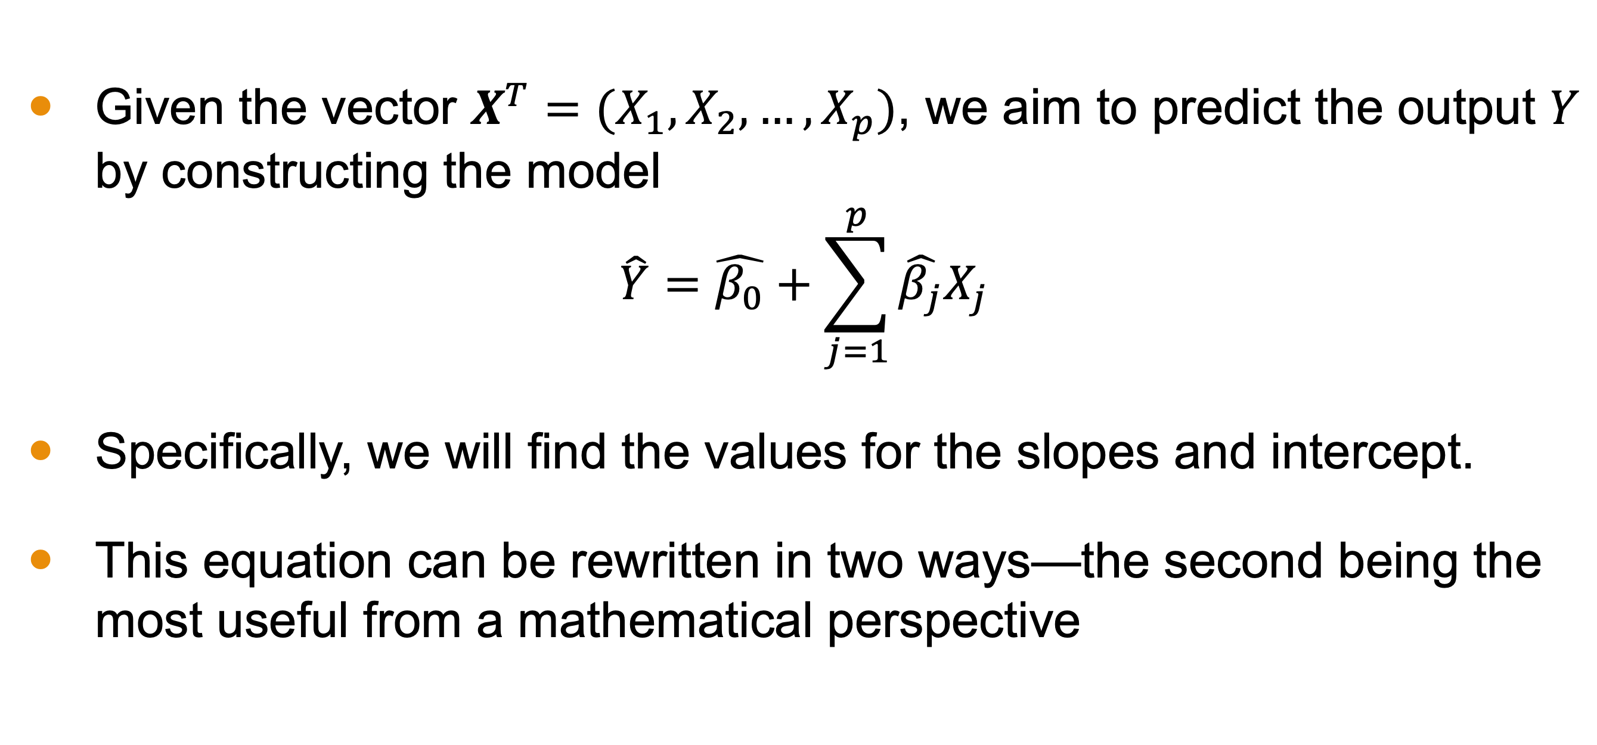
Formal Description
Given the vector $X^{T}=(X_{1}, X_{2}, …, X_{p})$, we aim to predict the output $Y$ by constructing the model
$$\hat{Y}=\hat{β_{0}}+\sum_{j=1}^{p}{\hat{β_{j}}X_{j}}$$
Specifically, we will find the values for the slopes and intercept.
This equation can be rewritten in two ways—the second being the most useful from a mathematical perspective

Slide 8
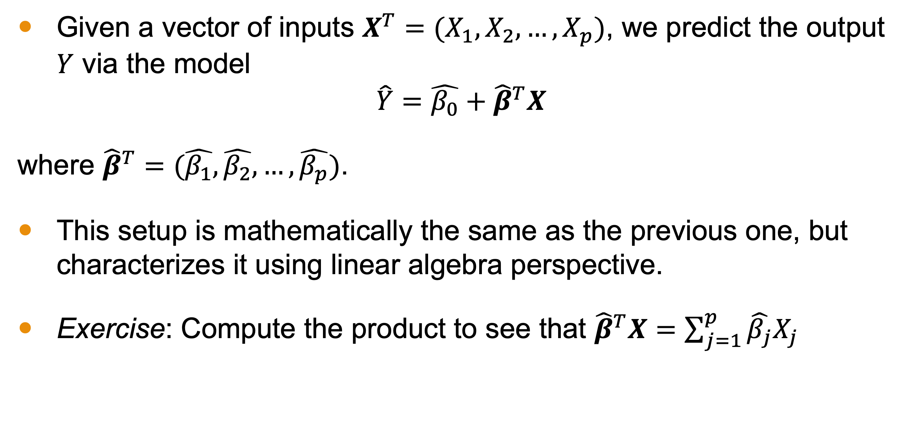
First Rewrite
Given a vector of inputs $X^{T}=(X_{1}, X_{2}, …, X_{p})$, we predict the output $Y$ via the model
$$\hat{Y}=\hat{β_{0}}+{\hat{β}}^{T}X$$
where ${\hat{β}}^{T}=(\hat{β_{1}},\hat{β_{2}}, …,\hat{β_{p}})$.
This setup is mathematically the same as the previous one, but characterizes it using linear algebra perspective.
Exercise: Compute the product to see that ${\hat{β}}^{T}X=\sum_{j=1}^{p}{\hat{β_{j}}X_{j}}$

Slide 9
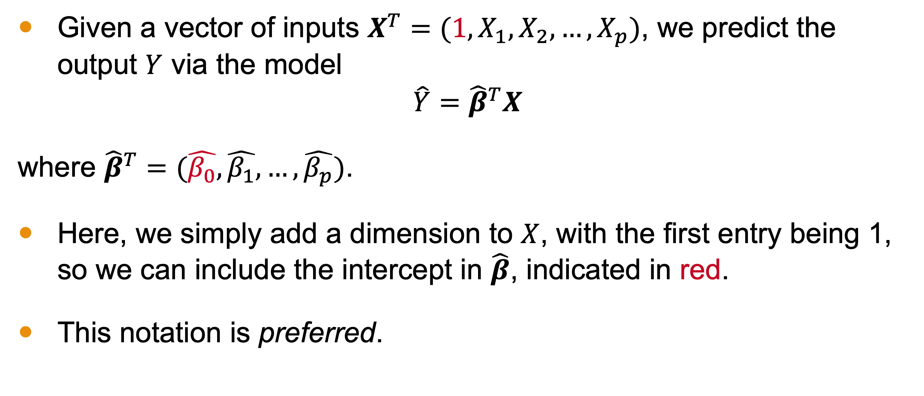
Third Rewrite
Given a vector of inputs $X^{T}=(1, X_{1}, X_{2}, …, X_{p})$, we predict the output $Y$ via the model
$$\hat{Y}={\hat{β}}^{T}X$$
where ${\hat{β}}^{T}=(\hat{β_{0}}, \hat{β_{1}}, …,\hat{β_{p}})$.
Here, we simply add a dimension to $X$, with the first entry being 1, so we can include the intercept in $\hat{β}$, indicated in red.
This notation is preferred.

Slide 10

Loss Function
When dealing with linear regression, we almost always pick a squared error loss function $L\left(Y,f(X)\right)={(Y −f(X))}^{2}$.
Why? It’s beyond the scope of this class, but it relates to Hilbert Spaces and their properties.
Notes:
An advanced undergraduate or first year graduate course in Functional Analysis will provide the background to better appreciate this.

Slide 11
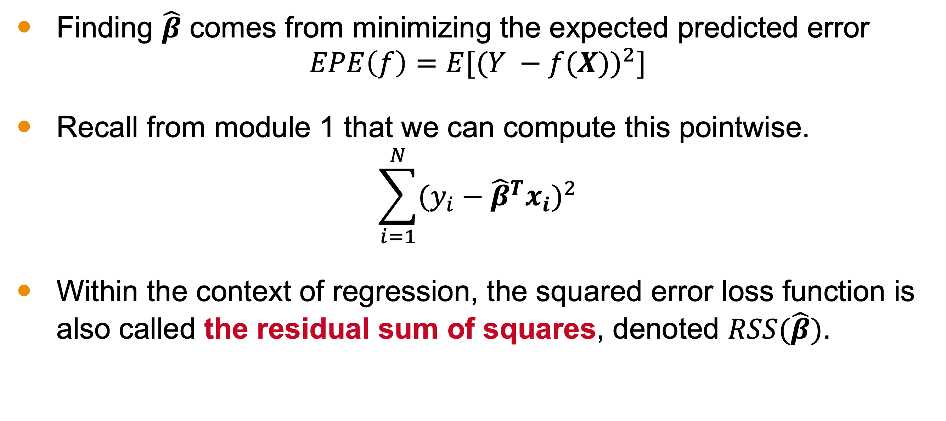
Minimizing Expected Prediction Error
Finding $\hat{β}$ comes from minimizing the expected predicted error
$$EPE\left(f\right)={E[(Y −f(X))}^{2}]$$
Recall from module 1 that we can compute this pointwise.
$$\sum_{i=1}^{N}{{(y_{i}−{\hat{β}}^{T}x_{i})}^{2}}$$
Within the context of regression, the squared error loss function is also called the residual sum of squares, denoted $RSS(\hat{β})$.
Notes:
An advanced undergraduate or first year graduate course in Functional Analysis will provide the background to better appreciate this.

Slide 12
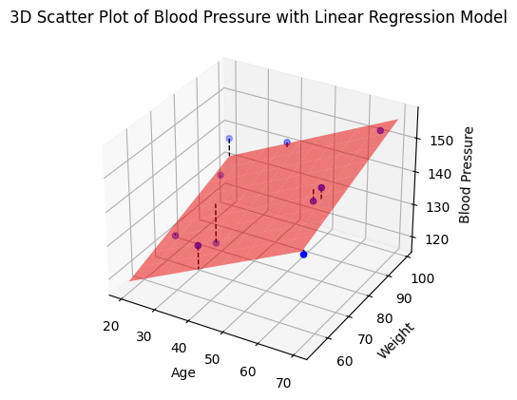
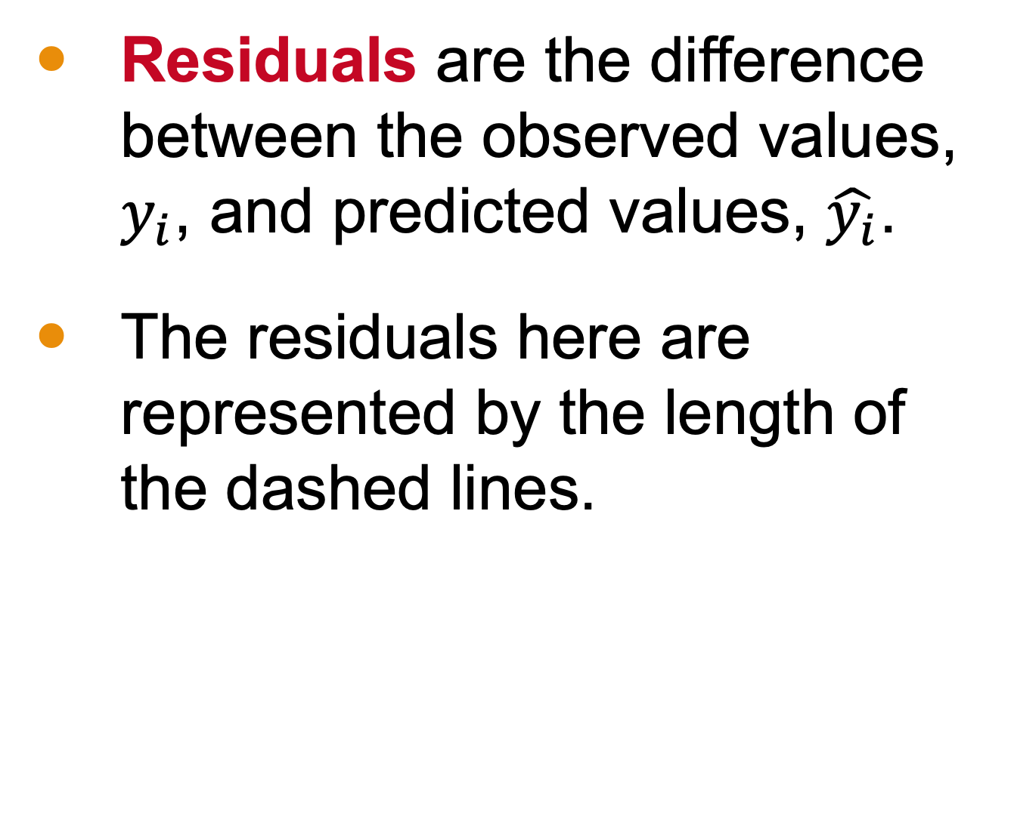
Residuals
Residuals are the difference between the observed values, $y_{i}$, and predicted values, $\hat{y_{i}}$.
The residuals here are represented by the length of the dashed lines.

Slide 13

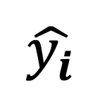
$\sum_{i=1}^{N}{{(y_{i}−{\hat{β}}^{T}x_{i})}^{2}}$
Residual Sum of Squares
Residuals
$$\hat{y_{i}}$$
Notes:
And, of course, it is a sum of squared values

Slide 14
So, how do we minimize?
Notes:
This is where the linear algebra comes in

Slide 15
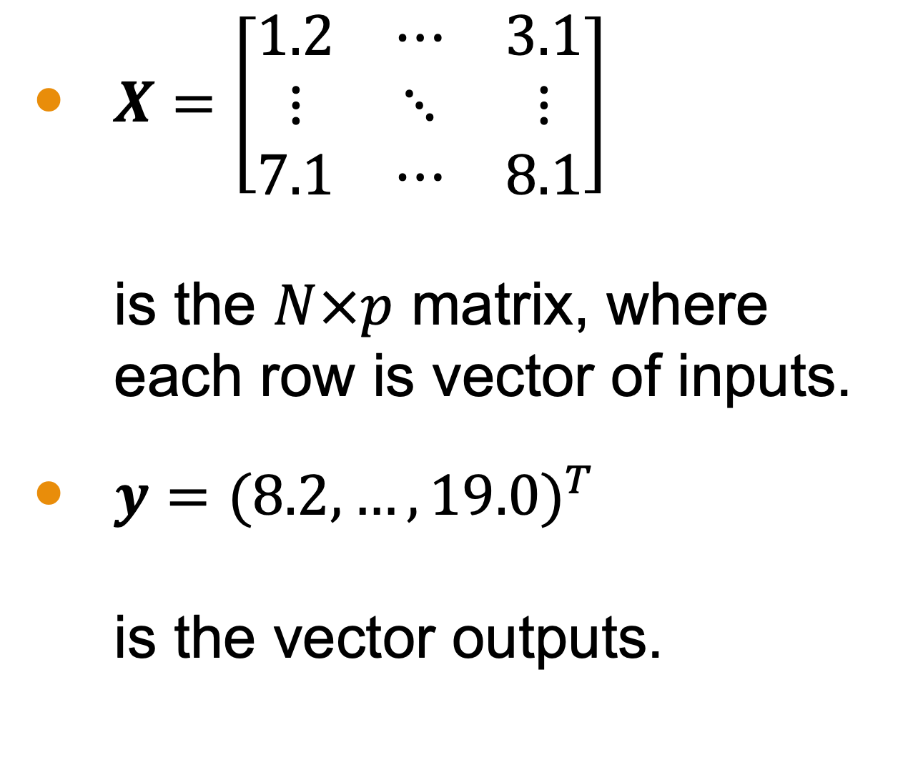
Notation
$X=\left[\begin{matrix}1.2 & ⋯ & 3.1 \\ ⋮ & ⋱ & ⋮ \\ 7.1 & ⋯ & 8.1\end{matrix}\right]$ is the $N×p$ matrix, where each row is vector of inputs.
$y={(8.2, …, 19.0)}^{T}$ is the vector outputs.
$$X_{1}$$ | $$X_{2}$$ | $$X_{3}$$ | $$Y$$
1.2 | 2.3 | 3.1 | 8.2
2.0 | 1.8 | 2.6 | 7.5
3.1 | 2.7 | 4.0 | 10.3
4.0 | 3.9 | 5.1 | 13.2
5.2 | 4.7 | 6.0 | 15.1
6.0 | 5.9 | 7.2 | 17.2
7.1 | 6.8 | 8.1 | 19.0
Notes:
An advanced undergraduate or first year graduate course in Functional Analysis will provide the background to better appreciate this.

Slide 16
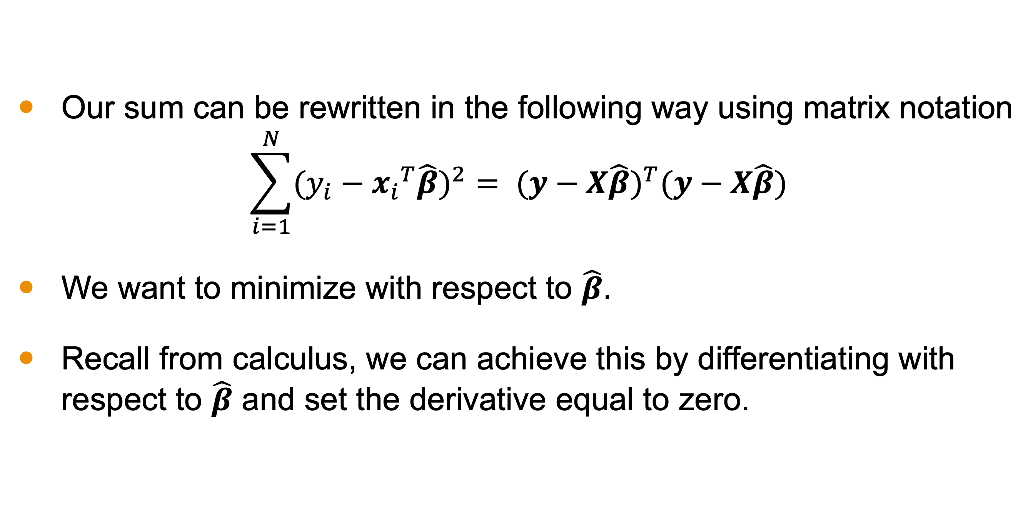
Minimization
Our sum can be rewritten in the following way using matrix notation
$$\sum_{i=1}^{N}{{(y_{i}−{x_{i}}^{T}\hat{β})}^{2}}= {(y−X\hat{β})}^{T}(y−X\hat{β})$$
We want to minimize with respect to $\hat{β}$.
Recall from calculus, we can achieve this by differentiating with respect to $\hat{β}$ and set the derivative equal to zero.

Slide 17
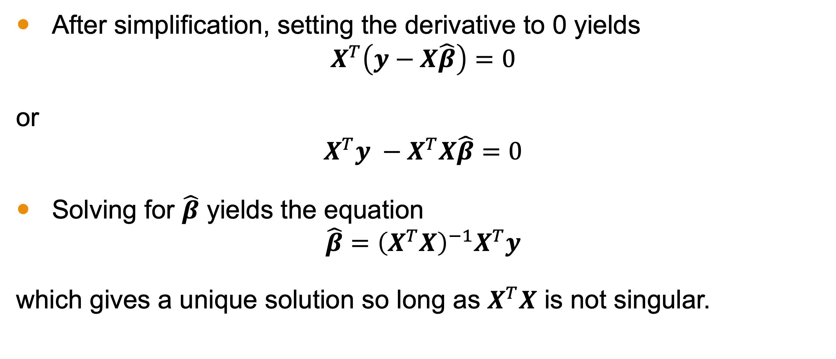
Minimization
After simplification, setting the derivative to 0 yields
$$X^{T}\left(y−X\hat{β}\right)=0$$
or
$$X^{T}y −X^{T}X\hat{β}=0$$
Solving for $\hat{β}$ yields the equation
$$\hat{β}={\left(X^{T}X\right)}^{−1}X^{T}y$$
which gives a unique solution so long as $X^{T}X$ is not singular.

Slide 18
Consequences
Linear regression is quite popular, partially because it has a closed form solution for the model.
We will see several other models in this class that do not have such a nice equation for coefficients.
This also has a nice geometric interpretation using matrix projection (see reading).

Slide 19
But how do we evaluate this model?
Notes:
This is where the linear algebra comes in

Slide 20
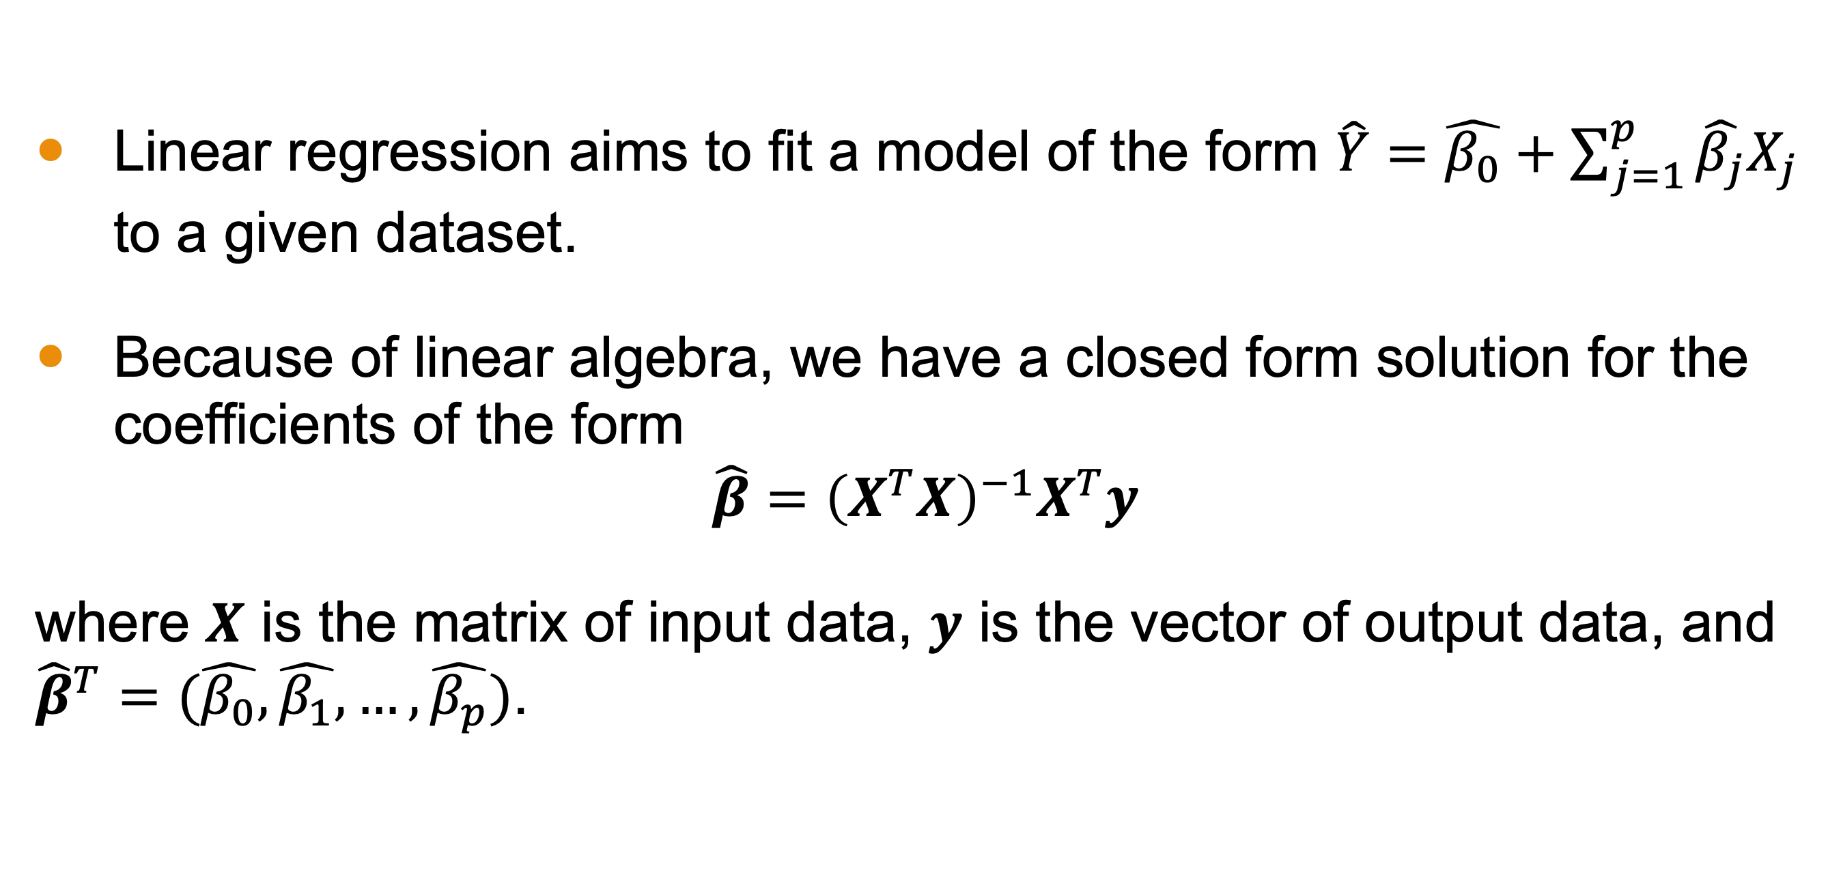
Conclusion
Linear regression aims to fit a model of the form $\hat{Y}=\hat{β_{0}}+\sum_{j=1}^{p}{\hat{β_{j}}X_{j}}$ to a given dataset.
Because of linear algebra, we have a closed form solution for the coefficients of the form
$$\hat{β}={\left(X^{T}X\right)}^{−1}X^{T}y$$
where $X$ is the matrix of input data, $y$ is the vector of output data, and ${\hat{β}}^{T}=(\hat{β_{0}}, \hat{β_{1}}, …,\hat{β_{p}})$.

